Slide 1
FACE RECOGNITION
ATTENDANCE SYSTEM
Engage 2022
PRESENTATION BY:
YASH GARG yg852062@student.nitw.ac.in

Slide 2
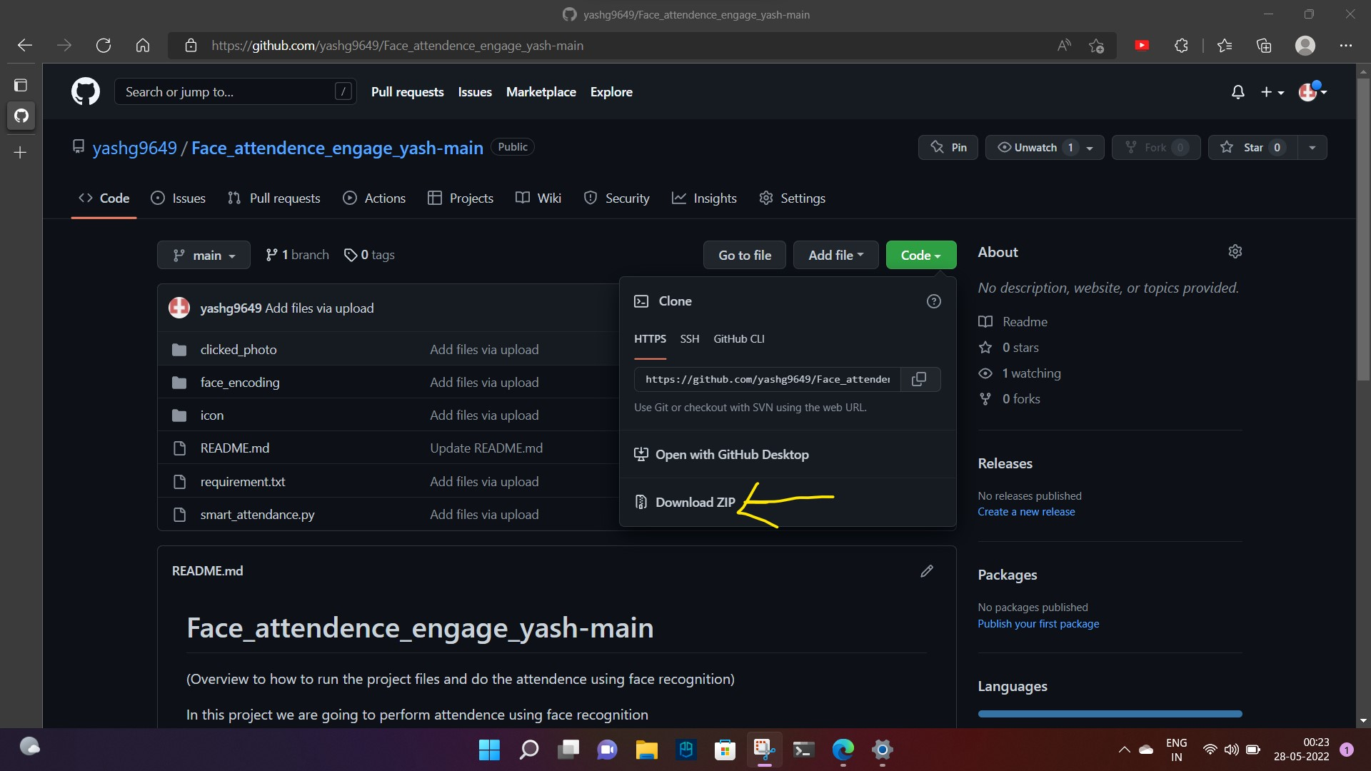
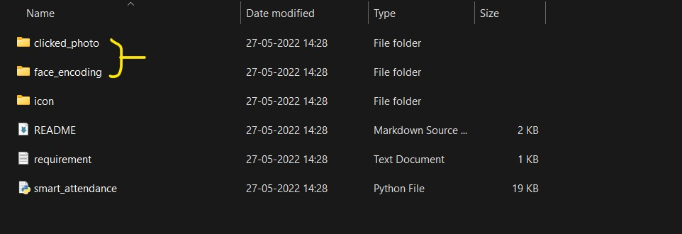
Download the zip file from github
2) delete the photo.txt file from clicked_photo folder And encode photo.txt file from face_encoding folder

Slide 3
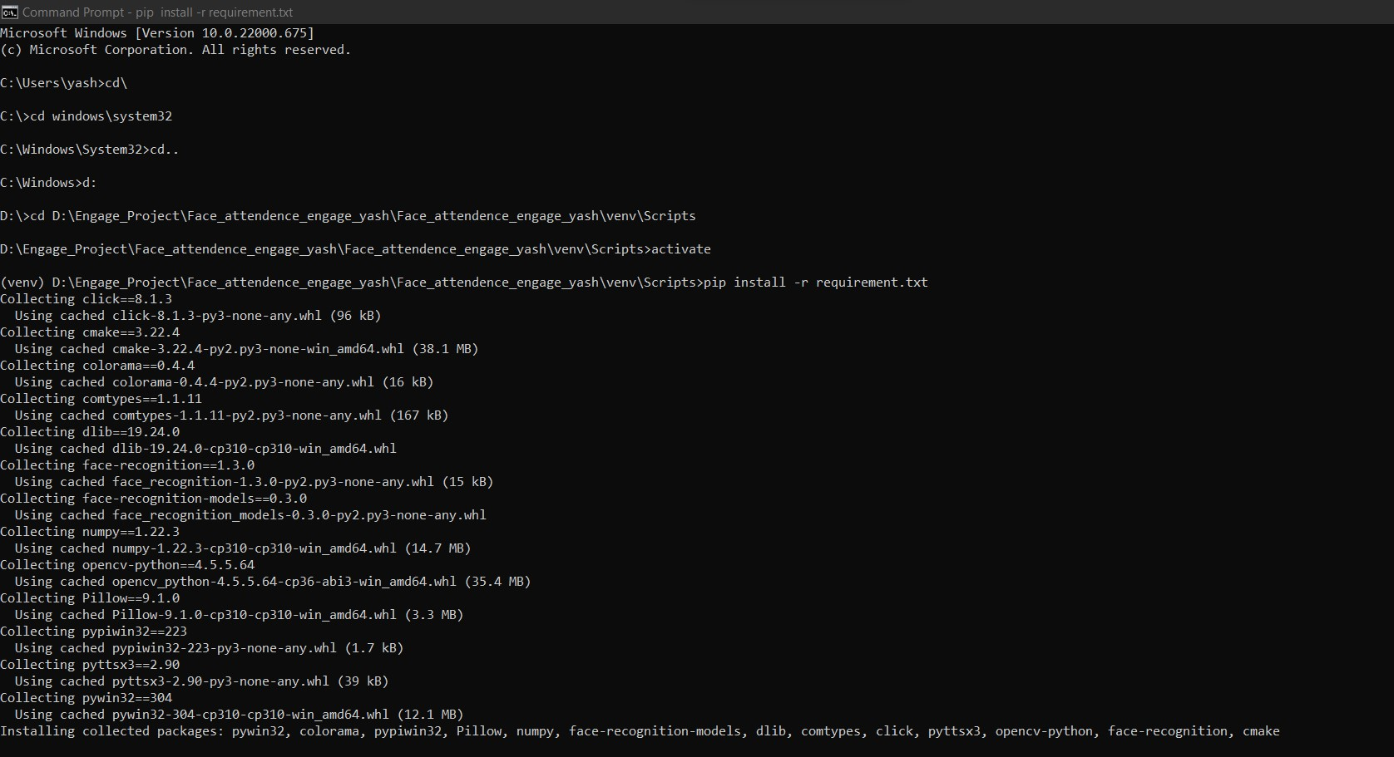
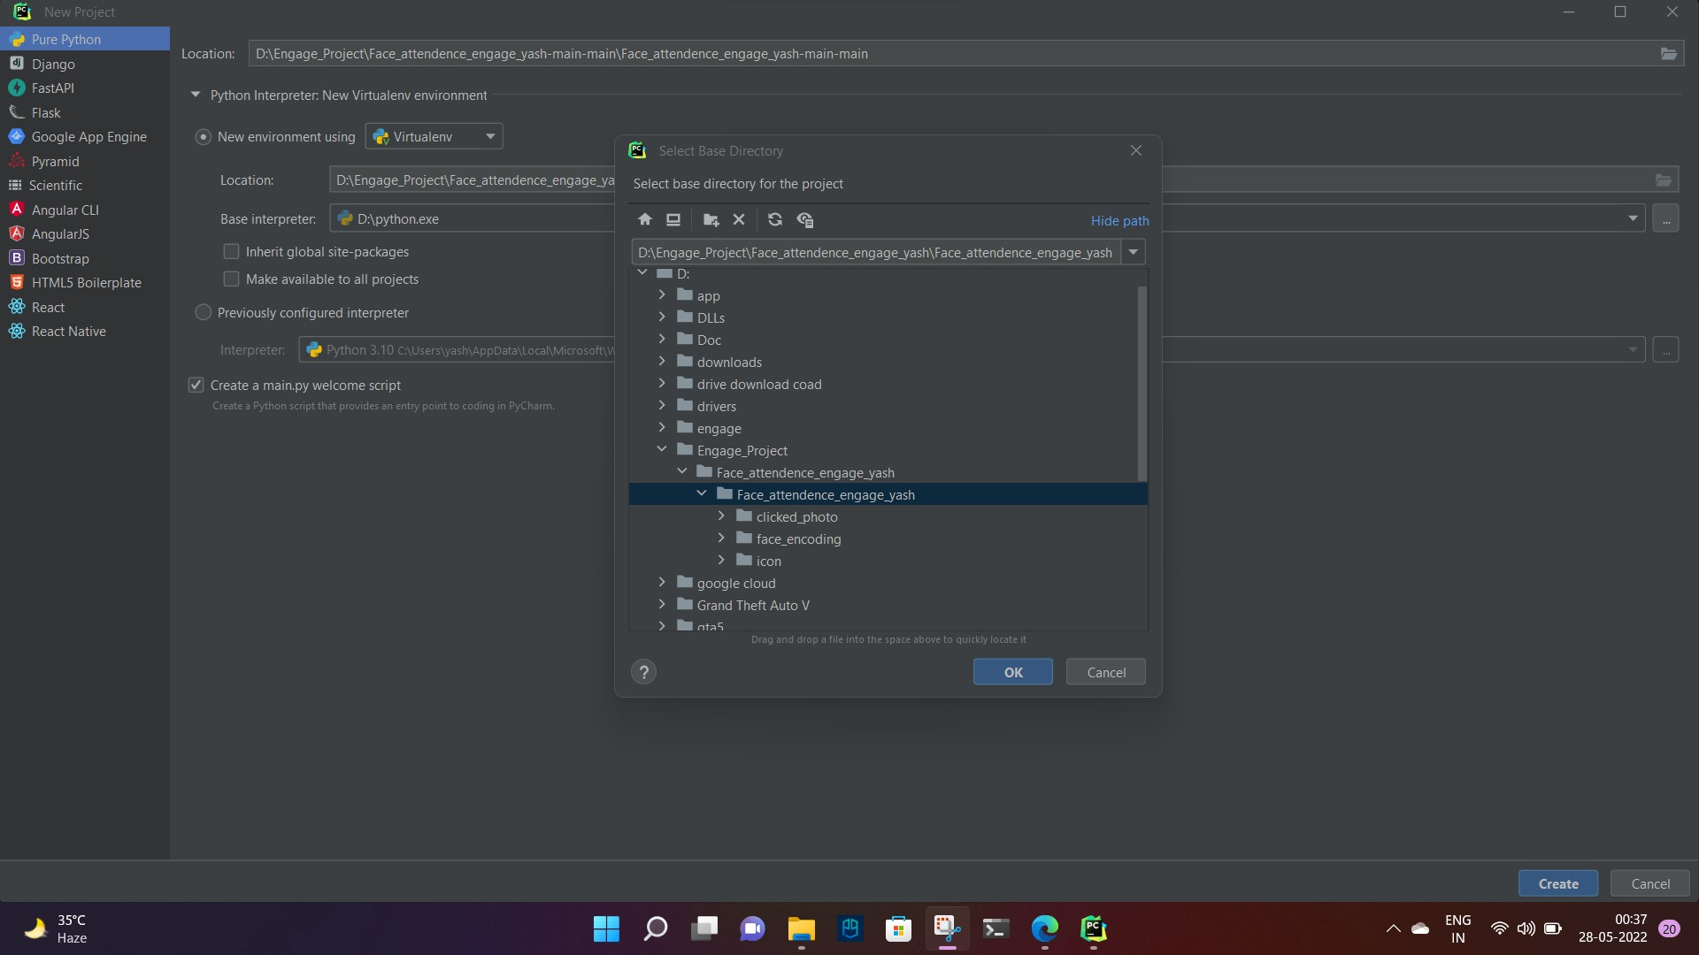
3) For installing the required packages from requirement.txt first save the requirement.txt file into venv\Scripts folder which we get after opening of our project in pycharm.
4) First activate the environment by running the file ‘activate’ in cmd then run ‘pip install -r requirement.txt’ to install the required packages.

Slide 4
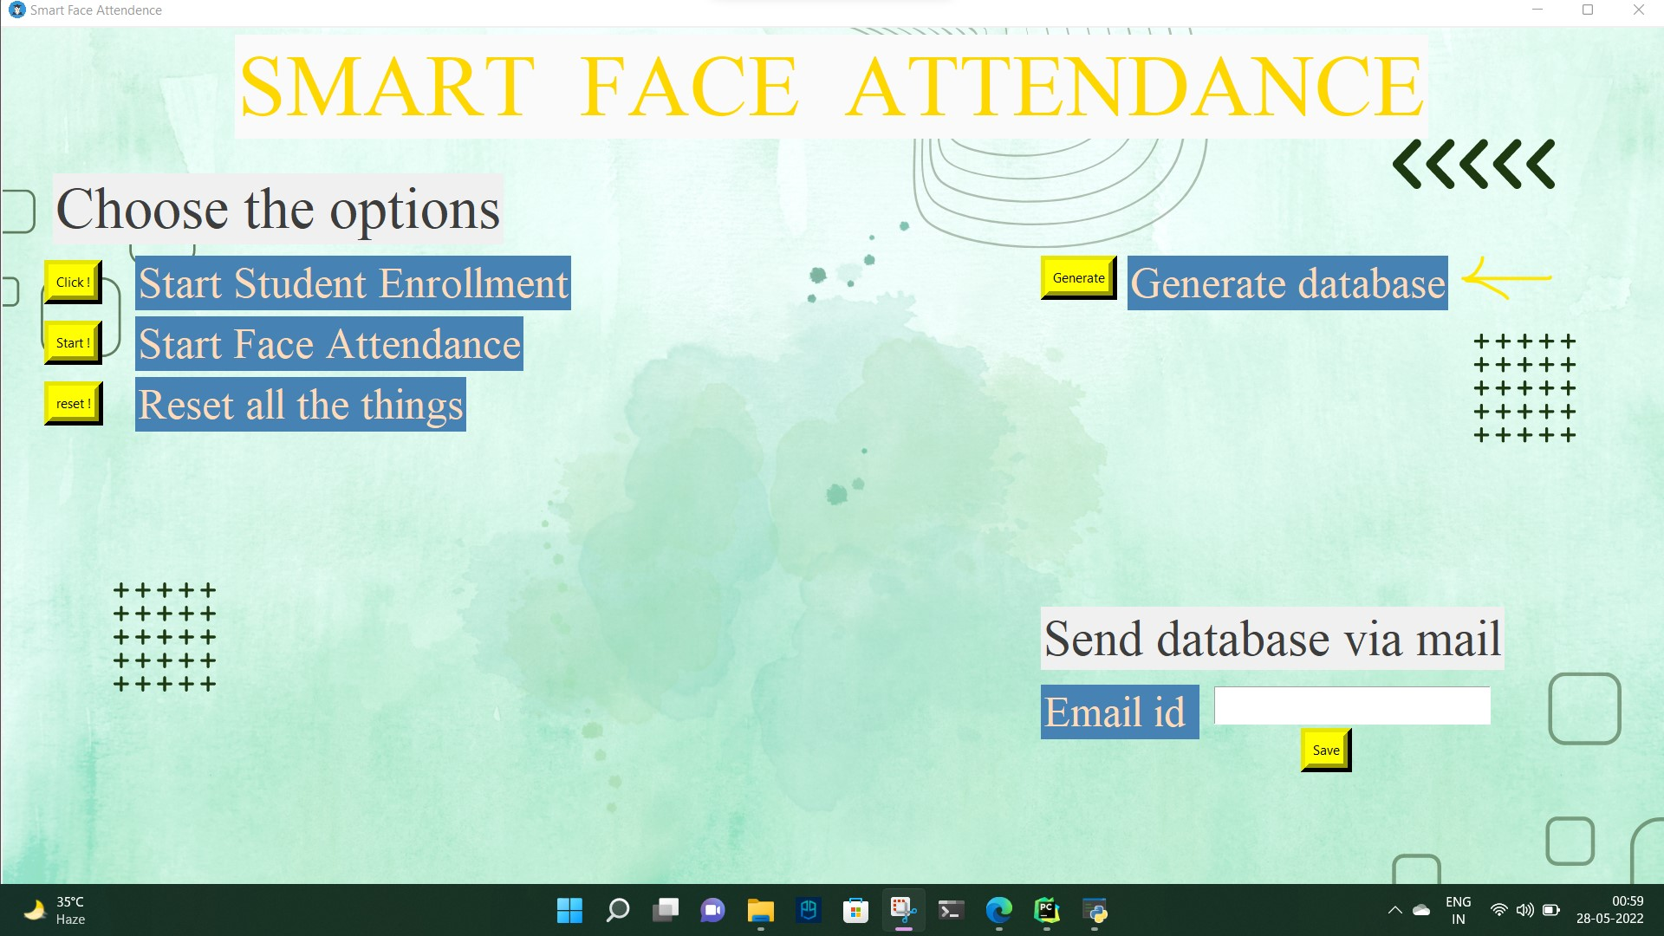
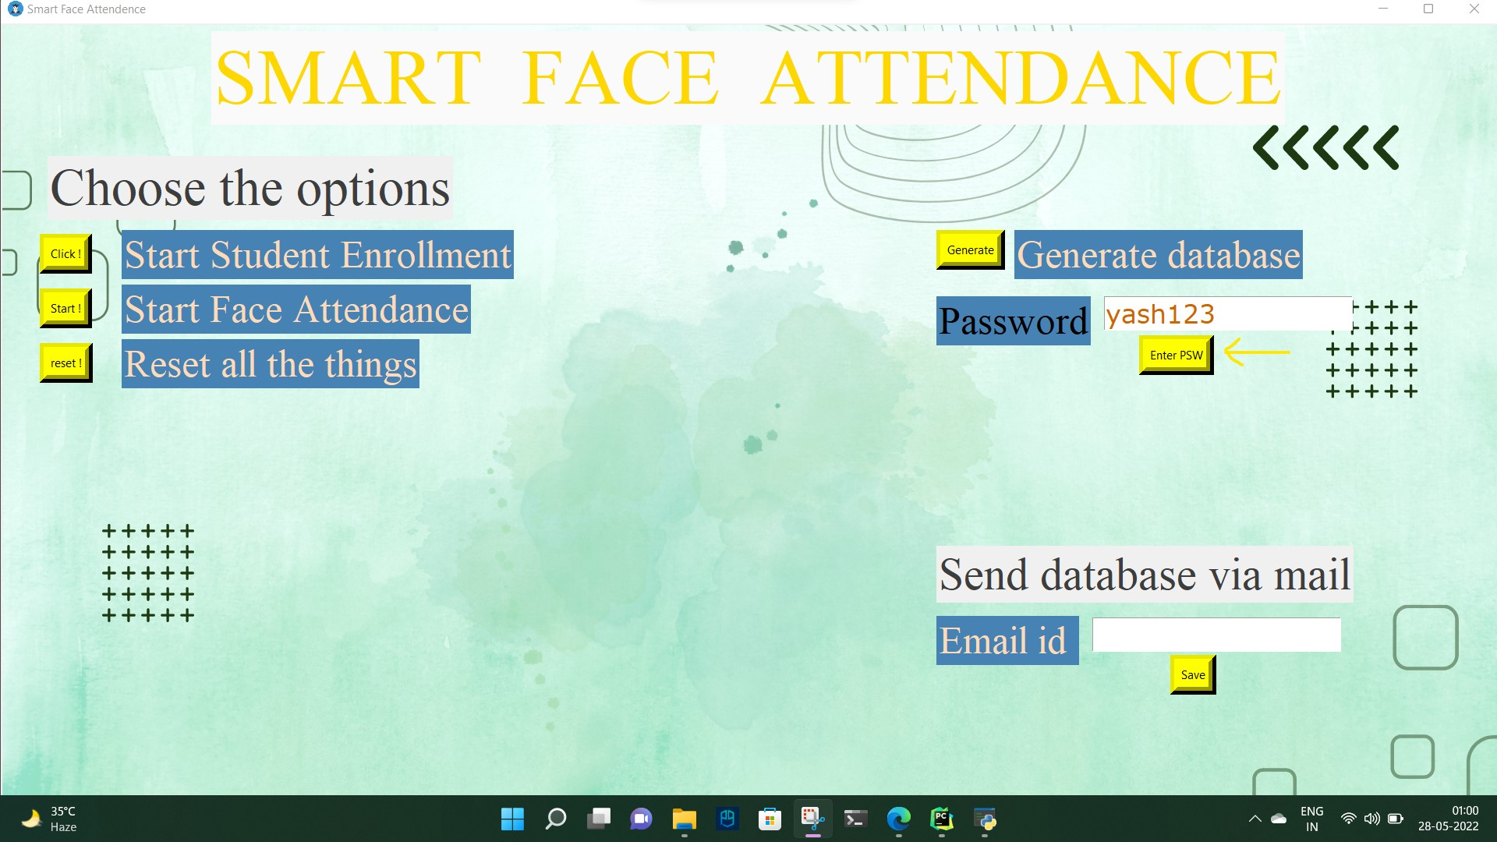
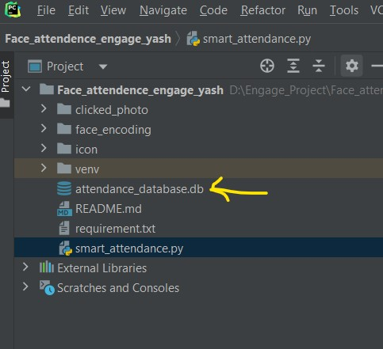
‘We can change the password from line 378 in smart_attendance.py file’
5) After running the python file showed window will open. First generate the database (using password - ‘yash123’) for storing the student data and attendance report.
Here I added the feature of password so that only authority has the access to create the database.

Slide 5

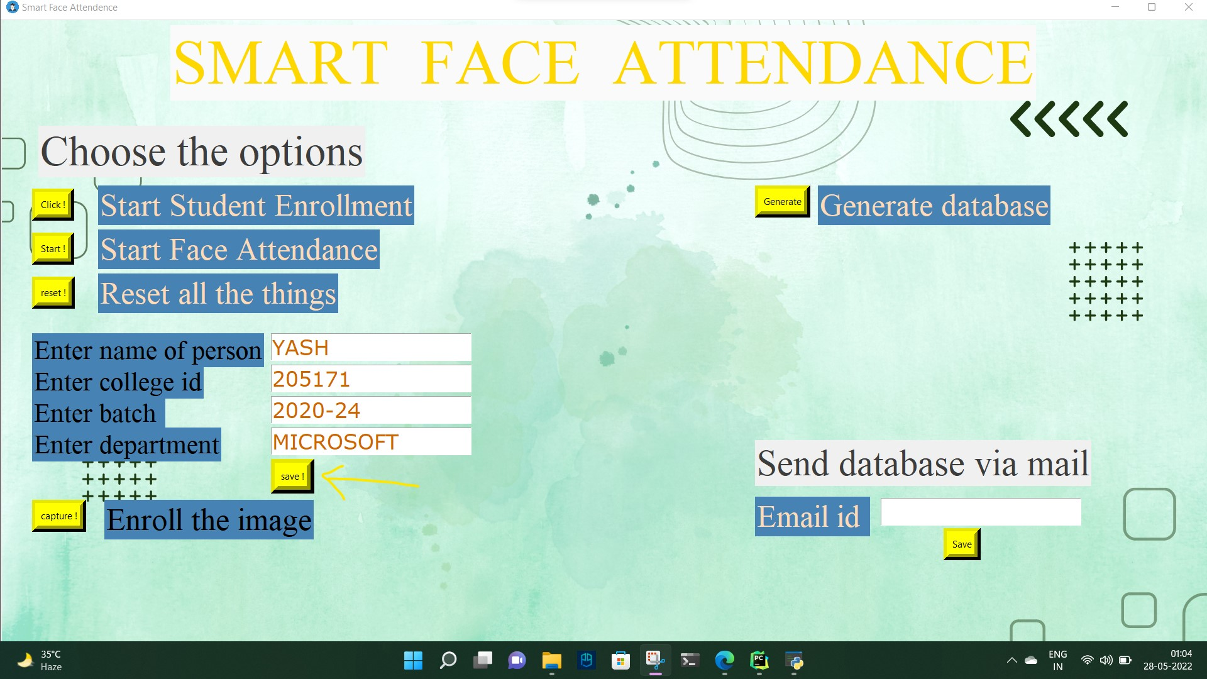

6) Now enroll the student face and data using ‘Start Student Enrollment’ button.
Now we can enter the students detail. Here I added the feature we can move from one filling box to another using ‘up’ and ‘down’ arrow key.
7) After clicking the ‘Save’ button click ‘Capture’ to save the image.

Slide 6
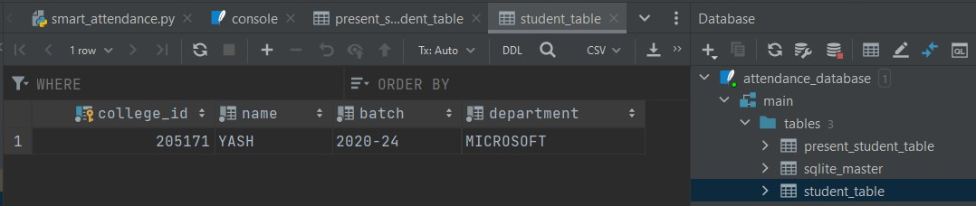
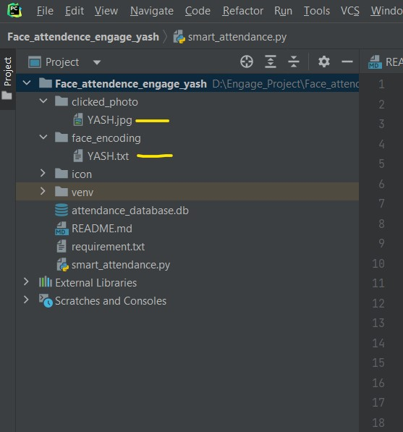
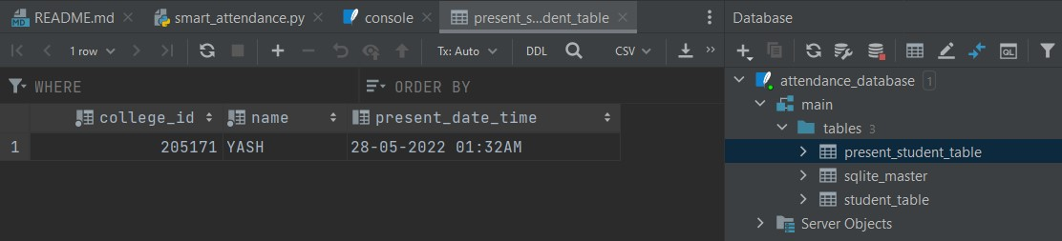

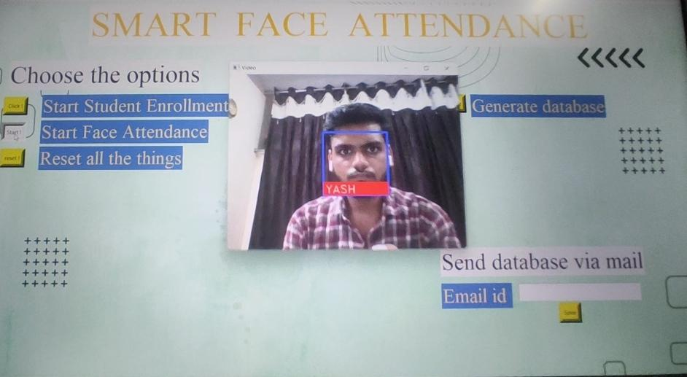
8) After enrollment of every student data, we can start the attendance. Click ‘Start Face Attendance’. As we can see in the last photo it showing the name (one time only) on the video. Now we can see the student logging time in the database table ‘present_student_table’.
Now I can verify photo enrollment in ‘clicked_photo’ and ‘face_encoding’ folder

Slide 7

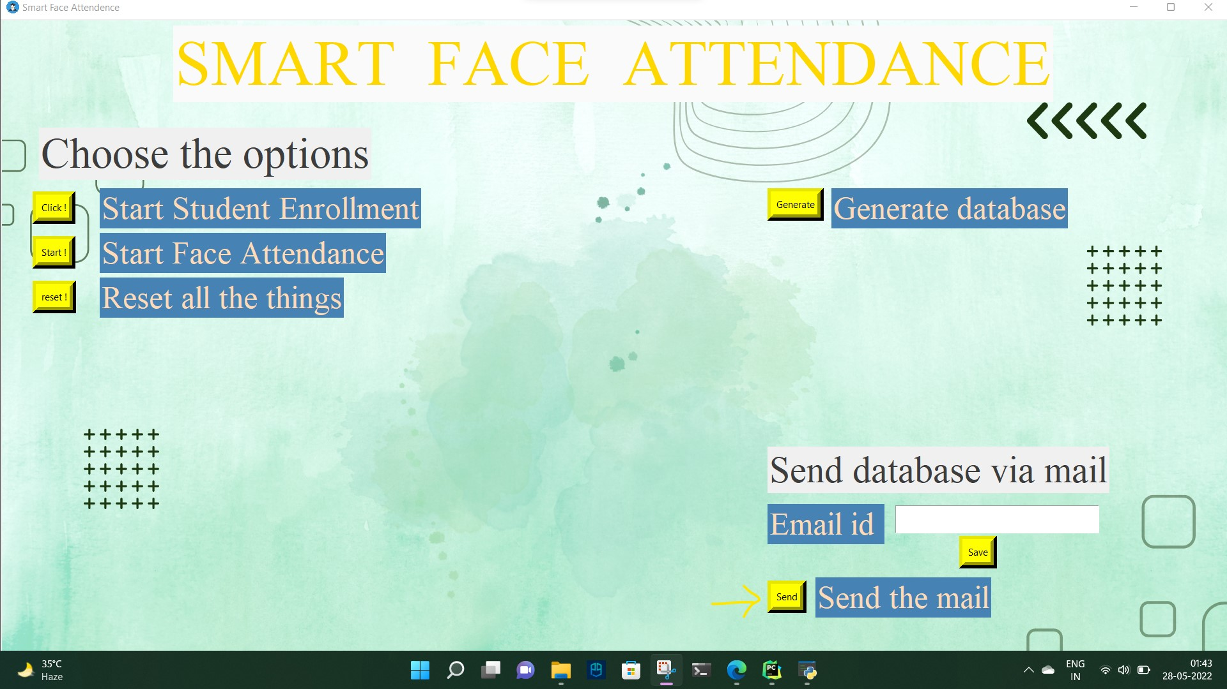
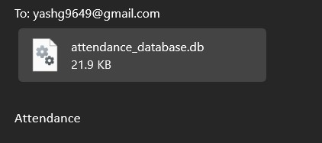
I added one more feature of sending the database to any person by mail
For now the mail is send by id - ‘ygarg042005@gmail.com’ we can change it from line 57, 79 from ‘smart_attendance.py’.

